Slide 1

Idea Sparks that Ignite a Digital Accessibility Strategy
508
#CSUNATC18
AUDIT
ARIA
ADA
WCAG

Slide 2
The Beginning

Slide 3
The Scenario
Fortune 25
Financial services - heavily regulated
Seven corporate business groups
Each with multiple lines of business (LOB) – covering 85 – 90 LOBs
Accessibility expertise and program maturity - rudimentary to evolved

Slide 4

The Challenge
There was no Digital Accessibility Program Manager
No automation of accessibility processes
Inconsistent implementation of enterprise policies and standards
Silos of work
Heterogeneous systems, devices and approaches
This Photo by Unknown Author is licensed under CC BY-NC

Slide 5

The Need
Clarity
Consistency
Automation
Integration
Infiltration
This Photo by Unknown Author is licensed under CC BY-NC

Slide 6
The Approach
Understand the current state of accessibility across the Lines of Business (LOBs)
Identify successes and gaps at the LOB and Group level
Define ways to fill the gaps by elevating successes to the enterprise model
Allocate resources to support the enterprise program and strategy
Must be actionable
Must be measurable
Must consider broad range of audiences with diverse needs

Slide 7
The Work

Slide 8

Discovery
Working sessions with the Enterprise Digital Accessibility Program Manager
Interviews
30 in-house accessibility subject matter experts and stakeholders
Multiple enterprise functions
UX designers, developers, QA testers, accessibility SMEs, product managers, content platform managers, risk and compliance managers
Face-to-face + phone
This Photo by Unknown Author is licensed under CC BY-SA

Slide 9

Distillation
Strategic Consulting
Conducting SWOT analysis
Formulating and prioritizing goals based on the interviews
Determining actions needed to achieve defined goals
Aligning resources to execute required actions
Identifying strategic pillars for the enterprise program
This Photo by Unknown Author is licensed under CC BY-NC-SA

Slide 10
Deliverables
Tools
Suggesting appropriate testing, tracking, and risk management tools by functional area
Development of risk management tools and framework
Metrics
Identify and refine Key Performance Indicators (KPIs)
Suggest ways to collect and report KPIs
Training
Provide approaches to enterprise role-based accessibility training
Leverage on-line training materials in Deque University
Documentation
Strategic Outline
Analysis of procedural and structural gaps
Summary of program specific recommendations in key areas including risk management, systems development, testing, technology enablement, procurement, 3rd party service provider management, and targeted support

Slide 11
The Results

Slide 12

Where Are We Now
Formalized enterprise accessibility strategy
Seven Core Pillars
Plan for rollout
Created new metrics
Updated policy
Obtained funding for tools and personnel resources
This Photo by Unknown Author is licensed under CC BY-NC

Slide 13
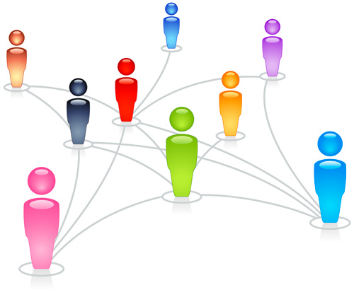
Lessons Learned
Engagement of stakeholder community is critical
Need external experts
Objective input and guidance
Have to start somewhere
Sometimes you just need to make a decision
Pick a point – date, process, policy - and start
Be open minded – you might need to change course
You don’t boil the entire ocean at one time
This Photo by Unknown Author is licensed under CC BY-NC-SA

Slide 14




Follow us / Questions
@dequesystems
dequelabs
deque-systems-inc
Dequesystemsinc
For information about Wells Fargo’s digital accessibility program email:
digital.access@wellsfargo.com

